Slide 1
MAR 580: Models for Marine Ecosystem Based Management
Lecture 10
Participatory Modeling
& Multicriteria Decision Analysis
29 April 2016

Slide 2
Simplified Schedule
Week | Topic | Assignments
1/29 | Intro to EBM, review of fisheries assessment models
2/5 | No Class - weather
2/12 | Stock assessment models with ecosystem processes
2/19 | Guest lecture: Food web models I (Ecopath) | HWK 1 due
2/26 | Guest lecture: Food web models II (Ecosim) | Project outlines
3/ 4 | Multispecies models, estimating species interactions
3/11 | Marine spatial planning models, marine reserve design | HWK 2 due
3/18 | SPRING BREAK
3/25 | No Class - IMS Research Symposium (several mini-lectures) | HWK 3 due
4/1 | Valuation of ecosystem services
4/8 | No Class – Stock Synthesis training course | HWK 4 due
4/15 | Whole of system models, MSE for ecosystems
4/22 | Qualitative modeling, model structure uncertainty | HWK 5 due
4/29 | Participatory modeling, multicriteria decision analysis
5/6 | Final exam: Project Presentations | Final papers

Slide 3
Today’s Outline
Participatory Modeling for EBM
Multicriteria Decision Analysis

Slide 4
Participatory Modeling
Initial reading exercise
Voinov, A. and Bousquet, F., 2010. Modelling with stakeholders. Environmental Modelling & Software, 25(11), pp.1268-1281.
Sections 1-3.

Slide 5
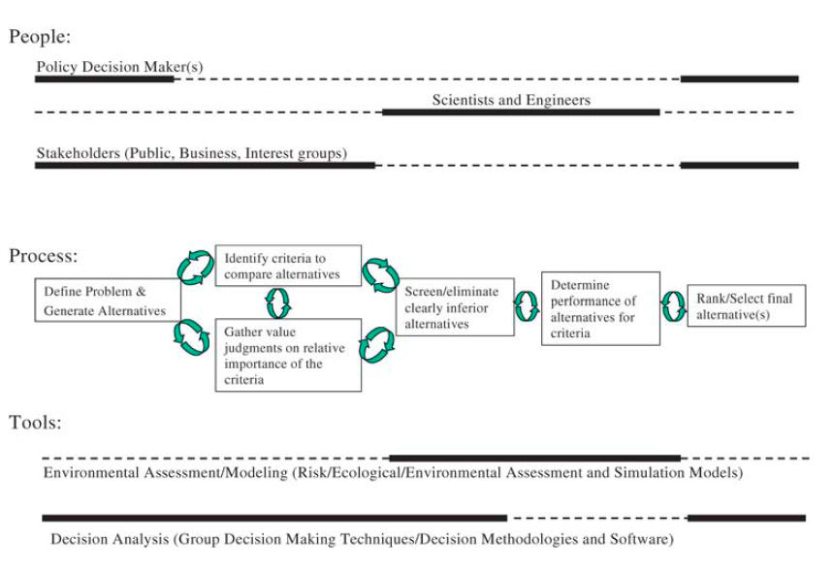
Decision making ingredients (Kiker et al. 1995)
Participatory approaches can help at all stages, but particularly with model steps associated with decision-making.

Slide 6
Participatory Modeling
Process of incorporating stakeholders into the modeling process.
Who are stakeholders?
Includes soliciting information to integrate scientific knowledge with local knowledge:
facilitate co-learning and co-understanding.
Goal driven:
know how the model will be used,
are creating models that stakeholders need.

Slide 7
Participatory Modeling
Facilitate and structure discussions between scientists and stakeholders about uncertainties and quality of knowledge base.
Can contribute to collective learning, increase legitimacy, and advance scientific understanding.
Need to clearly identify the problem.
Emphasis is on treating the model as a process rather than product: keep it flexible.
JAKFISH project (e.g. Rockman et al. 2012) showed that participatory modeling requires an effective facilitation strategy:
scientists, stakeholders and policy-makers actively connect and discuss.
Need to train the participants in these processes.
Success requires a realization that PM builds and is built on trust.
Requires time and effort.
“Participatory modeling tries to cut down on some of the ambiguities and assumptions that we have that are inlaid informally in our head.”
(Stephen Gray, Mental Modeler)
Notes:
Need to identify clear problem and lead stakeholders
Stakeholders should be engaged early and often.
Working groups should be appropriately representative (relates to identifying problem).
Modeling tools should be appropriate to answer clearly identified questions. Keep it simple.
Accept modeling methodology before presenting model results.
Incorporate all forms of stakeholder knowledge
Engage stakeholders in discussions regarding uncertainty
Develop scenarios that are both feasible and most effective
Interpret results in conjunction with stakeholders, facilitate development of new policy and management ideas, engage stakeholders in reporting results
Promote adaptive management, adaptive modeling, and adaptive decision making.
Maintain societal and scientific openness, and transparency of methods and models.
Rely on collaborative research, and open source models
Trust and acknowledgement of conflict Is important. Mind the people. Be aware of social and group dynamics, special interests, power and hierarchies.
Facilitate and encourage learning - learn from each other and the process.
Emphasis is on treating the model as a process rather than product: keep it flexible.

Slide 8
Types of participation
Passive participation: objective is just to inform people.
Extractive use: knowledge, values, or preferences are synthesized by the extracting group and passed on as a diagnosis to a decision-making process.
the scientists are HUNGRY and need data!
Participation to support decisions: stakeholders are used to promote and articulate the chosen decisions.
Interactive participation: stakeholders share diagnostic and analytical methods, tools, or results (co-learning).
Self-organization: lessons from the participatory process are transformed into decisions by the stakeholders themselves (co-management).

Slide 9
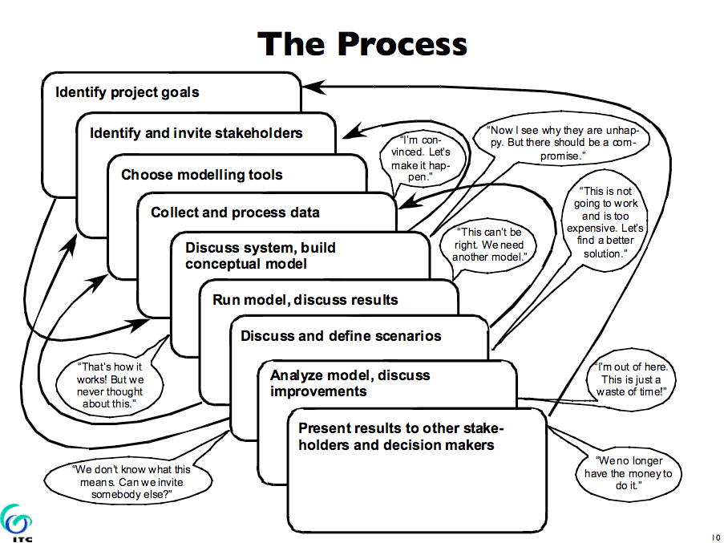
here

Slide 10
Software tools for participatory modeling
System dynamics:
Stella, Vensim, Powersim, Madonna, Simile, Extend, GoldSim, Simulink
Fuzzy cognitive mapping:
FCMapper, Mental Modeler
Bayesian networks:
Netica, Hugin, Analytica, DBLi
Agent based:
Repast, NetLogo, Mason, Cormas

Slide 11
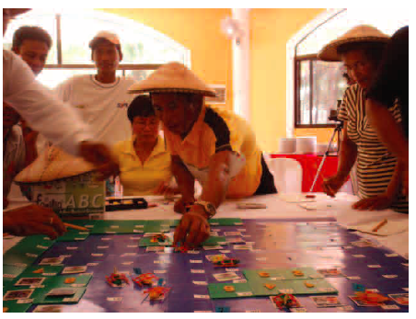
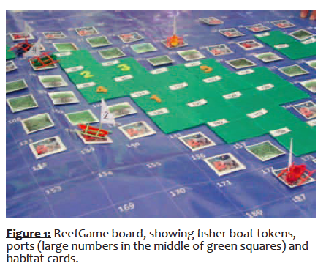
Participatory gaming tools
Model and role-play games
can be aimed at policy makers and industry representatives.
simulate coastal development trajectories and trade-offs between environmental, social and economic concerns.
e.g. ReefGame (Cleland et al. 2010) is a local-level model and board game that helps local people and reef managers explore interactions between livelihoods, reefs and fisheries (also JAKFISH simulation game).
Powerful way to educate and involve the public in coral reef management
can also force stakeholders to consider alternative processes
reveal preferences, priorities, and behavior that can be useful in more detailed models.
Fun and play in participatory context had positive impact on stakeholder engagement in Mexico and Philippines
Outcomes of gaming workshops may or may not be linked to ongoing projects / management priorities.

Slide 12
Baltic Sea herring (Haapasaari et al. 2009)
Stakeholder process to develop biological models for Baltic Sea herring fishery and the evaluation of policy advice using these models.
Build alternative model structures from current knowledge of the stakeholders -compared to a model provided by biological research.
Models used as an interactive forum to enhance common understanding about the fishery system and consensus about management actions.
What are 5 most important factors affecting survival of eggs, mortality, growth of herring? Is the effect positive or negative? What are strengths of factors? How much uncertainty is there?
Which variables should be taken into account in herring management? What should the objectives be? What kind of management measures could be used to reach these objectives?
Graphical representation of variables and their linkages.

Slide 13
A brief note on Bayesian networks
Are emerging as a valid approaches for modeling and supporting decision making in resource management.
Couple a graphical representation of the system with probabilistic models for feedbacks and interactions.
Allow different types of data to be linked together in a way that allows for integrated analysis
Graphical nature of presentation allows a multidisciplinary perspective, making approach usable for stakeholder participation and discussion (Castelletti and Soncini-Sessa, 2007, Bromley et al. 2005).

Slide 14
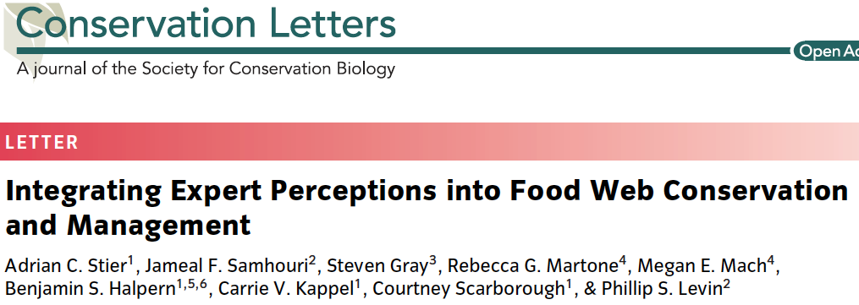
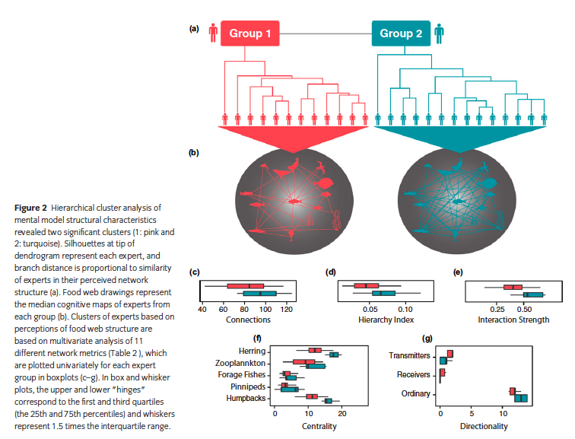
Stier paper

Slide 15
LAB: Atlantic Herring MSE, Mental Modeler
We are interested in evaluating the performance of alternative control rules for Atlantic herring.
How will a range of control rules perform with respect to a set of objectives?
What are the factors we need to consider for the dynamics of the herring fishery?
What should the objectives of management of the herring fishery be?
Notes:
Would like to account for role as forage in ecosystem, stabilize fishery at level designed to achieve OY, address localized depletion in inshore waters.

Slide 16
Break!

Slide 17
Participatory approaches to objective setting
Central question:
How do scientific processes take into account the multi-objective nature of fisheries management?
One strategy:
develop participatory facilitation tools that could be used to clarify negotiations over management strategies by making the trade-offs among alternative management strategies more transparent.
A stakeholder-based process of objective setting and performance evaluation is often considered core to practical applications of Management Strategy Evaluation.

Slide 18
Multicriteria Decision Analysis
Reading exercise
Punt, A. E. Strategic management decision-making in a complex world: quantifying, understanding, and using trade-offs. ICES Journal of Marine Science, doi: 10.1093/icesjms/fsv193.
Section on “Selecting Management Strategies”
Huang, I.B., Keisler, J. and Linkov, I., 2011. Multi-criteria decision analysis in environmental sciences: ten years of applications and trends. Science of the total environment, 409(19), pp.3578-8594.
Sections 1 & 2.

Slide 19
Multicriteria Decision Analysis (MCDA)
Involves the simultaneous use of multiple indicators and information source (both qualitative and quantitative) to assist in decision making.
(a) Generate priority ranking of issues for use of management resources:
1. identifying the highest priority issue,
2. a short list of issues for additional appraisal;
3. to distinguish between acceptable and unacceptable issues
(b) Compare relative performance of different management options across a number of competing fishery objectives or differing stakeholder preferences.
Common purpose of MCDA methods is to evaluate and choose among alternatives based on multiple criteria using systematic analysis that overcomes limitations of unstructured individual or group decision making.

Slide 20
MCDA steps
Identify the objectives or criteria that will be used to influence the final choice.
Should be clearly specified, ideally measurable, and, so far as possible, mutually independent.
Forecast for each policy option, the expected levels for each decision criterion.
Assign a preference measure to each of these criteria levels for each policy option.
may be a proportionate score (linear) or a utility value (nonlinear).
Assign weights to be applied to the preference measures for the different criteria.
Weighting function may be linear and additive or of some other form.
Calculate the measure of overall value or merit to determine the best option using a simplistic weighted average of the scores (or more sophisticated method).

Slide 21
Analytic Hierarchy Process
Most common of methods used in resource management
Uses pairwise comparisons of criteria which ask how much more important one is than the other, rather than utility and weighting functions.
All individual criteria must be paired against all others and the results compiled in matrix form.
Relies on the supposition that humans are more capable of making relative judgments than absolute judgments.

Slide 22
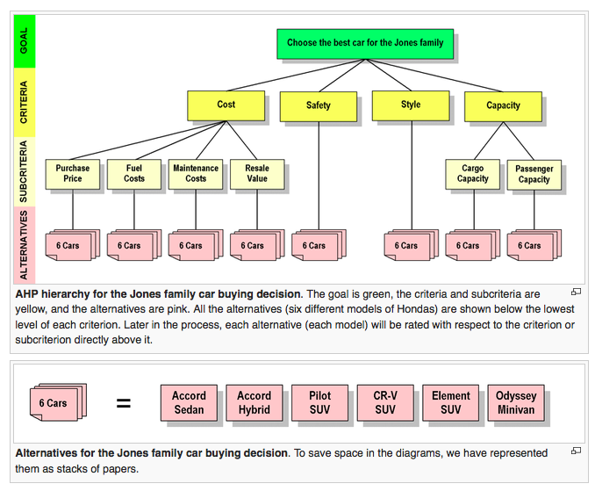
Example: Car buying
cars

Slide 23
MCDA in participatory settings
MCDA tools can be applied to assess value judgments of individual decision makers or multiple stake-holders.
An advantage of an MCDA approach in group decisions is capacity for calling attention to similarities or potential areas of conflict between stakeholders with different views.
MCDA can also be used as a framework that permits stakeholders to structure their views about the pros and cons of different environmental and remedial management options.
Sustainable Ecosystem Management
MCDA methods can help in finding sustainable ecosystem management strategies and policies, including sustainable use of ecosystem services according to combined ecological, social and ecological criteria.

Slide 24
Reading
Bromley, J., Jackson, N.A., Clymer, O.J., Giacomello, A.M. and Jensen, F.V., 2005. The use of Hugin® to develop Bayesian networks as an aid to integrated water resource planning. Environmental Modelling & Software, 20(2), pp.231-242.
Castelletti, A. and Soncini-Sessa, R., 2007. Bayesian Networks and participatory modelling in water resource management. Environmental Modelling & Software, 22(8), pp.1075-1088.
Haapasaari P., Mäntyniemi S., Kuikka S. (2009). Participatory modeling to enhance understanding and consensus within fisheries management: the Baltic herring case. ICES CM 2009/O:13.
Melbourne-Thomas, J., C. R. Johnson, P. Perez, . Eustache, E. A. Fulton, and D. Cleland. 2011. Coupling biophysical and socioeconomic models for coral reef systems in Quintana Roo, Mexican Caribbean. Ecology and Society 16(3): 23.
Röckmann C., Ulrich C., Dreyer M. et al., (2012). The added value of participatory modelling in fisheries management–what has been learnt. Marine Policy, 36: 1072–1085.
Stier, A.C., Samhouri, J.F., Gray, S., Martone, R.G., Mach, M.E., Halpern, B.S., Kappel, C.V., Scarborough, C. and Levin, P.S., 2016. Integrating expert perceptions into food web conservation and management. Conservation Letters.
Voinov A., Bousquet F. (2010). Modelling with stakeholders. Environmental Modelling & Software, 25: 1268-1281.
Saarikoski, H.; Barton, D.N.; Mustajoki, J.; Keune. H.; Gomez-Baggethun, E. and J. Langemeyer (2015): Multi-criteria decision analysis (MCDA) in ecosystem service valuation. In: Potschin, M. and K. Jax (eds): OpenNESS Ecosystem Service Reference Book. EC FP7 Grant Agreement no. 308428. Available via: www.openness-project.eu/library/reference-book
FAO EAF Planning and Implementation Tools. Multi-Criteria Decision Analysis (MCDA) Also Known as Multi-Objective Decision Analysis (MODA)
Huang, I.B., Keisler, J. and Linkov, I., 2011. Multi-criteria decision analysis in environmental sciences: ten years of applications and trends. Science of the total environment, 409(19), pp.3578
Kiker, G.A., Bridges, T.S., Varghese, A., Seager, T.P. and Linkov, I., 2005. Application of multicriteria decision analysis in environmental decision making. Integrated environmental assessment and management, 1(2), pp.95-108.
Mardle, S. and Pascoe, S., 1999. A review of applications of multiple-criteria decision-making techniques to fisheries. Marine Resource Economics, pp.41-63.

Slide 25
Next time on Models for Marine EBM….
(May 6)
Project presentations (20 mins each)

Slide 26
Questions?

Slide 27
Lab Example (MCDA), using Fay et al. (2015)
Selecting among strategies using APH.
Multispp. model of Georges Bank finfish.
Objectives (3)
Total catch (of all species)
Proportion of species not overfished
Inter-annual CV of total catch
Should there be more?
Alternatives: 3 indicator based control rules, and single species (FMSY) management.
Use APH to select strategy.

